Slide 1
EC601:Photonics chips in machine learning on audio process
Sprint 4
Team 16: Taozhan Zhang

Slide 2
Recap
Sprint 3:
Finish the literature review and select the appropriate application parts for research

Slide 3
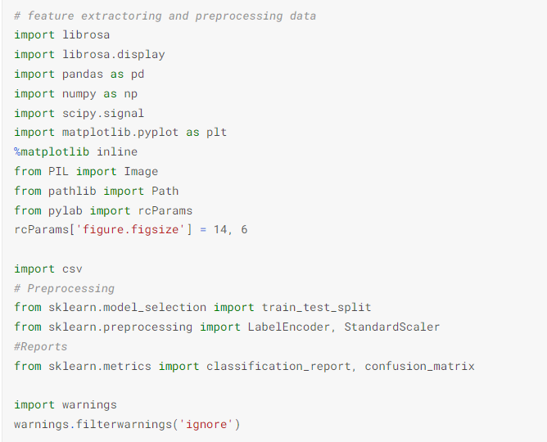
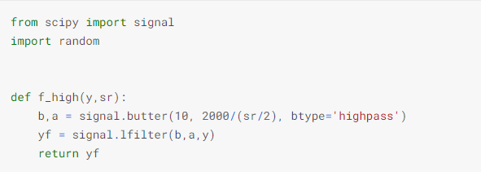
Noise cancellation using Python

Slide 4

Audio sample

Slide 5
Next step
Make a Poster
Keep on researching for the more effective and practical noise cancellation techniques

